Slide 1
Natural Selection
Team Awesome Humble
Nohemi, Tommy, Madison, Eric, Anna, and Marissa

Slide 2
Natural Selection Survival of the Fittest
Standard 7.d: Students know variation within a species increases the likelihood that at least some members of a species will survive under changed environmental conditions.
Students should be able to:
Predict how differing genetic traits will increase probability of survival in a given environment.
Develop a hypothesis explaining how alterations to the environment gave dark forms of peppered moths advantages over pale forms during the Industrial Revolution.
Learning Goal
Learning Outcomes

Slide 3
Who’s Hungry? Engagement Activity
Break into teams of two
Each team should have: 2 predatory spoons, 1 black tree, 1 white tree, white moths, black moths
Put all moths on the white background.
You and your partner have 30 seconds to eat (use spoon) as many moths as you can (you may only eat one moth at a time).
NOTE – you want to eat as many moths as possible in order to survive.

Slide 4
Discussion Questions
What did you guys notice during this activity?
What happened on the white background?
What happened on the black background?
Which color moth survived better in each environment?
These moths were each the same species, what caused the color difference?
Genetic variation
Mutation
Which genes were passed with greater frequency when the trees were white? When the trees were black?

Slide 5
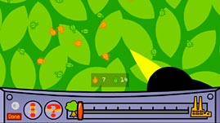
Nowhere to Hide

Slide 6
One-Minute Essay
Predict what happened to the moths when the pollution decreased?

Slide 7
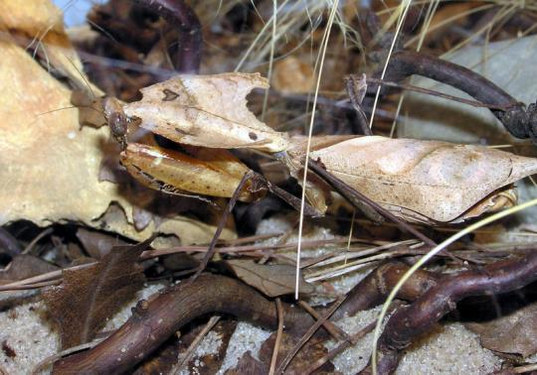
Connections to the World
Pygmy Sea Horse
Dead Leaf Mantis

Slide 8
Some Considerations…
Diversity
Learning styles → visual, auditory, kinesthetic
Video → what about colorblind students?
Consider pairing males and females together
Assessment
Discussion after engagement activity
One-minute essay
Mimicry connection
Alignment

