Slide 1
Please remove the purple “Prior Knowledge Survey” from section 4
Please fill it out while we are awaiting others to arrive; assume it is yesterday morning before the start of our institute.

Slide 2
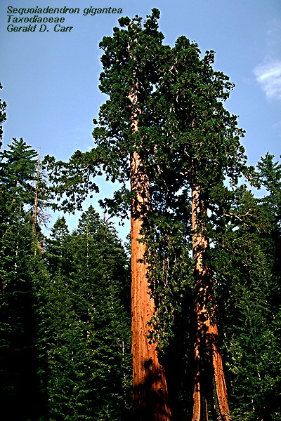
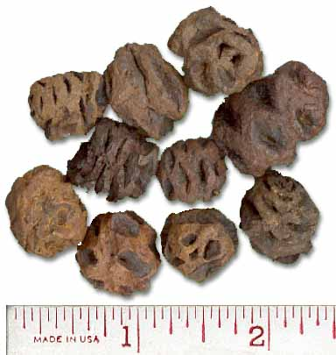
seeds: ~0.5”
Where did the redwood tree mass come from to create arguably the biggest organism on Earth?
Carbon Dioxide
Soil nutrients/minerals
Sunlight
Water

Slide 3
Biology 5A Announcements
1. Please have your clickers out ready to use.
Today’s lecture: Water
Lecture outline: Learning Outcomes:
--polar character --relating structure of water
--hydrogen bonds to its properties
--hypothetico-deductive experiment
--properties of water (4 properties) --decorating molecules with H₂0
(adhesion)
--framing questions in a
hypothetico-deductive fashion
cohesion, adhesion,
specific heat, state changes

Slide 4
UCR’s Summer Institute learning outcomes:
Develop awareness of Scientific Teaching as pedagogy
Enrich teaching skills
Experience new teaching methods
Cultivate a culture of community sharing and peer review
Build upon collective knowledge of participants
Renew an awareness of interdisciplinarity

Slide 6
Themes of Scientific Teaching
Active Learning- students are engaged in constructing their own learning
Backward design-establishing learning outcomes and course activities and activities accordingly
Assessment- students and instructors are able to gauge learning
Diversity- contribution from a diverse group of students enhances learning

Slide 7
Assessment
How do you know when you know something?
How do you know when your students know something?
How do your students know when they know something?

Slide 8
Formative assessments
Summative assessments
Classroom assessments, homework, online assignments
Occur frequently during the teaching event
Provide regular feedback to both the instructor and the students during the learning process
Exams, papers, presentations
Typically occur at the end of teaching
Usually major part of class grade

Slide 9
EnGaugements:
Using Active Learning Activities for Assessment
“When you ask a student to do something, they are simultaneously engaged in learning and can gauge their progress by whether or how well they can perform.”
Handelsman et al., 2006 Scientific Teaching.

Slide 10
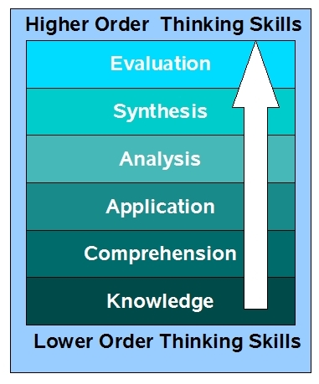
Bloom’s Taxonomy
Applying Bloom’s Taxonomy to Assessment
Associated Verbs (active words)
Predict, assess, evaluate
I
Formulate, develop, create
Calculate, compare, contrast
II
Apply, illustrate, use
Classify, explain, describe
III
Define, label, list
Scientific Teaching Table 5.6
http://blogs.wsd1.org/etr/files/blooms_taxonomy.jpg
Notes:
Useful exercise to Bloom’s exam questions

Slide 11
The molecule shown above is a(n):
A. Amino Acid D. Triglyceride
B. Fatty Acid E. Steroid
C. Carbohydrate

Slide 12
The molecule shown above is a(n):
A. Amino Acid D. Triglyceride
B. Fatty Acid E. Steroid
C. Carbohydrate
Assemble the following functional groups and atoms into an amino acid:
NH₂ COOH C SH CH2

Slide 13
The following equation: A²+B²=C² is called:
Quadratic equation
The Pythagorium Theorem
Occam’s razor
Gordian knot

Slide 14
The following equation: A²+B²=C² is called:
Quadratic equation
The Pythagorean Theorem
Occam’s razor
Gordian knot
The Pythagorean Theorem can be applied to the dimensions of which geometric shape?

Slide 15
Now take your own exams and rate several questions as to a Bloom’s level
I
II
III

Slide 16
Now convert a lower level Bloom’s to a higher level Bloom’s question
I
II
III

Slide 17
5E Cycle for Planning Effective Lessons
1. Engage – Spark Interest
2. Explore – Provide hands-on activities which freely explore the topic at hand
3. Explain – Facilitate student understanding by clarifying ideas, introducing vocabulary…
4. Extend (Elaborate) - Facilitate students applying new ideas to new situations
5. Evaluate – Provide appropriate ways for students to show their new skills and knowledge.
Is there evidence of this approach in our institute so far?

Slide 18
Diversity activity: creating an inclusive classroom
Teaching method | Who is excluded? | What can be changed?
Powerpoints used exclusively.
Exams are timed.
Science study halls are after school.
Assignments require internet research.
There is a fee for entering the science fair.
Teacher only calls on volunteers.

Slide 19
Diversity learning outcomes: you be the teacher!
Assemble a catalog of diversity types (Bloom’s category 1).
Propose the role of diversity in the context of teaching and learning. (Bloom’s category 1).
Evaluate how diversity contributes to a lack of engagement. (Bloom’s category 1).
Create a learning activity addressing the assigned diversity learning outcome and justify your choice.

Slide 20
Based on the “Scientific Teaching” article, what changes might you suggest for your own institution?

Slide 21
Create a Concept Map using the following terms:
Backward Design, Active Learning, Assessment, Diversity, Teachable Unit, Teachable Tidbit, Alignment
Feel free to use any additional terms from the Scientific Teaching book

Slide 22
What needs clarification from yesterday? What issues would you like to share regarding your early steps in developing your tidbit?

Slide 23
Framework for developing a Teachable Tidbit:
Set learning goals
Translate learning goals into specific learning outcomes
Plan learning activities to engage a diverse group of students (assessment)
Check if activities and learning goals align (yesterday; ”Consciously monitor”)

