Slide 1

SMI 2010
Summer Institute
Bradley Hyman
Amy Prunuske

Slide 2

“One minute essay”
When you decided to enroll in the class, what was your definition of “Scientific Teaching” and how did that definition change after doing your reading assignment?
Name

Slide 3
Broad learning goals for SMI Summer Institute:
Participants will understand the major concepts behind scientific teaching and explore ways to apply them to their teaching.
Specific learning outcomes:
Participants should be able to:
Define scientific teaching and identify ways to apply it to their own teaching.
Employ backward design to assess student learning.
Incorporate active learning exercises to engage students in the course material.
Develop a teachable unit that includes assessment and diversity components.
To achieve these outcomes: Let’s divide into three disciplinary groups;
Math, Science, and Interdisciplinary groups

Slide 4

Case: Frustrated Teacher
Before the semester started, I worked really hard to set goals for the course. During the semester, I have been covering the content in clear efficient lectures that I think are really well-organized, but the students don’t seem to be learning the material. In fact, 40% of students failed the first exam!
Students these days don’t know how to take notes and study. They just don’t get it.

Slide 5
Discussion of case: The frustrated teacher
What issues might be contributing to this situation?
Has the teacher done his/her job?
Have the students done their jobs? What challenges might they be facing?
What suggestions do you have for the teacher?

Slide 6
Themes of Scientific Teaching
Active Learning- students are engaged in constructing their own learning
Assessment- students and instructors are able to gauge learning
Diversity- contribution from a diverse group of students enhances learning

Slide 7
Case history: Constructing Science Knowledge:
I really struggle to teach evolution. Students get lost in the details and miss really big concepts like Darwin’s natural selection and genetic variation. How can I make them understand the importance of these concepts? No matter what I say, many of the students’ answers are trivial and superficial.
Case history: Constructing Mathematics Knowledge:
I really struggle to teach algebra. Students get lost in the details and miss really big concepts like the properties of real numbers (associative, communitive, distributive properties). How can I make them understand the importance of these concepts? No matter what I say, many of the students’ calculations are trivial and superficial.

Slide 8
Scientific Teaching Approaches
Backward Design-
1) Define clear, measurable learning outcomes
2) Create learning outcomes that help students to integrate material and to develop critical thinking skills
3) Design activities to help students achieve learning goals
Alignment- Determine if activities helped achieve the goals and revision of materials based on feedback. (at the end)

Slide 9
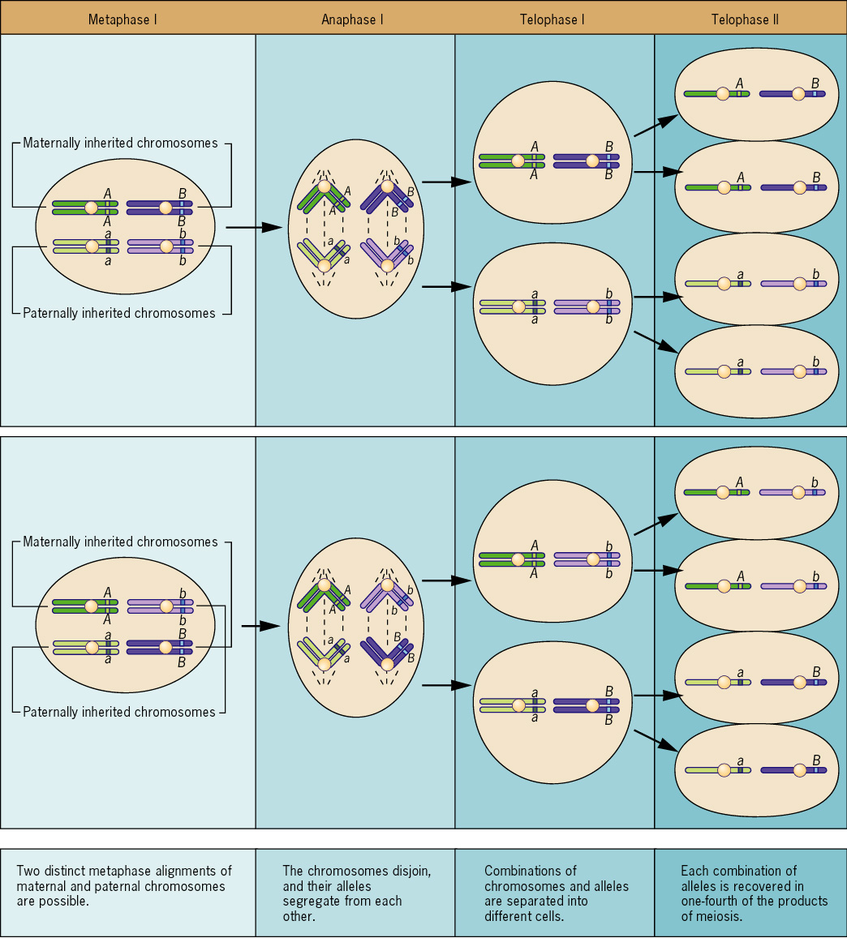
Start with Backward Design
Start with Backward Design
Broad learning goal:
Understand the process of growth (mitosis) and reproduction (meiosis).
Specific learning outcomes: Tell students the level of understanding they should achieve
Student should be able to:
Diagram mitosis and meiosis.
Compare and contrast the goals of mitosis and meiosis.

Slide 10
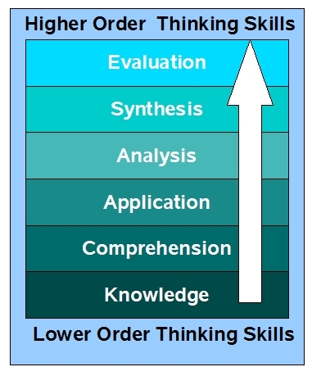
Bloom’s Taxonomy
Backward design your learning goals and outcomes
to help students achieve higher order thinking skills
Associated Verbs (active words)
Predict, assess, evaluate
Formulate, develop, create
Calculate, compare, contrast
Apply, illustrate, use
Classify, explain, describe
Define, label, list
Scientific Teaching Table 5.6
http://blogs.wsd1.org/etr/files/blooms_taxonomy.jpg
Notes:
Useful exercise to Bloom’s exam questions

Slide 11
Backward Design Activity:
Take learning objective from your own classroom and make list of learning outcomes designed toward achieving higher level Bloom’s

Slide 12
What is Active Learning?
Anything that students do in a classroom other than merely passively listening to an instructor's lecture.
Students are engaged in their own learning.

Slide 13
Passive vs. Active
Learning Strategies
Passive
Active
Listen to lectures.
Record facts for
later memorization.
Reflect, think about, apply, and verbalize concepts in the course.
Transmissionist
Constructivist
Generate a list of what you know about types of active learning strategies.
Group brainstorming.

Slide 14
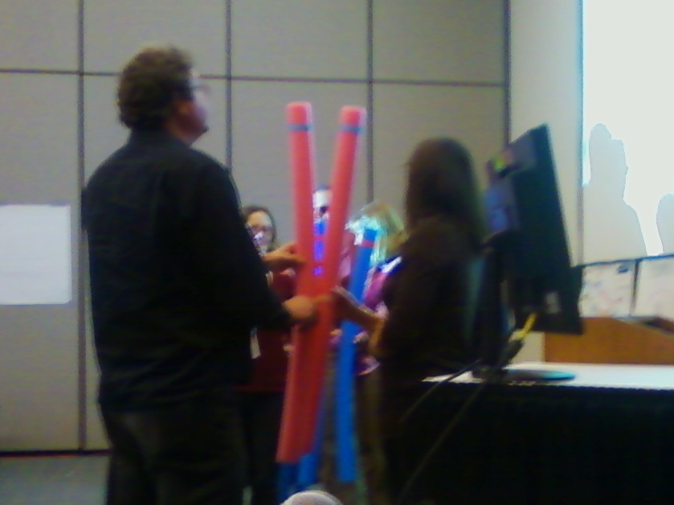
Active Learning Strategies
Group or individual activities:
Think-pair share
“Clicker” questions
Brainstorming
Reflection-One-minute questions
Statement Correction
Concept maps
Case and problem based learning
Strip Sequence
Jigsaw

Slide 15
Why active learning?
Enhance learning with active participation.
Uncover misconceptions.
Create dissonance challenging students to reconstruct their understanding.
Facilitate assessment of student learning.

Slide 16
Passive to Active Lecture: With your group provide examples of how topics in your discipline might be delivered using passive versus active learning
(in your packet)

Slide 17
Active Learning Summary:
Consciously monitor your teaching (Alignment)
Why did I use this teaching activity?
Does this activity align with my learning goals?
Did this activity help achieve outcomes I set for my students?
Would I use or modify this activity in the future?

Slide 18
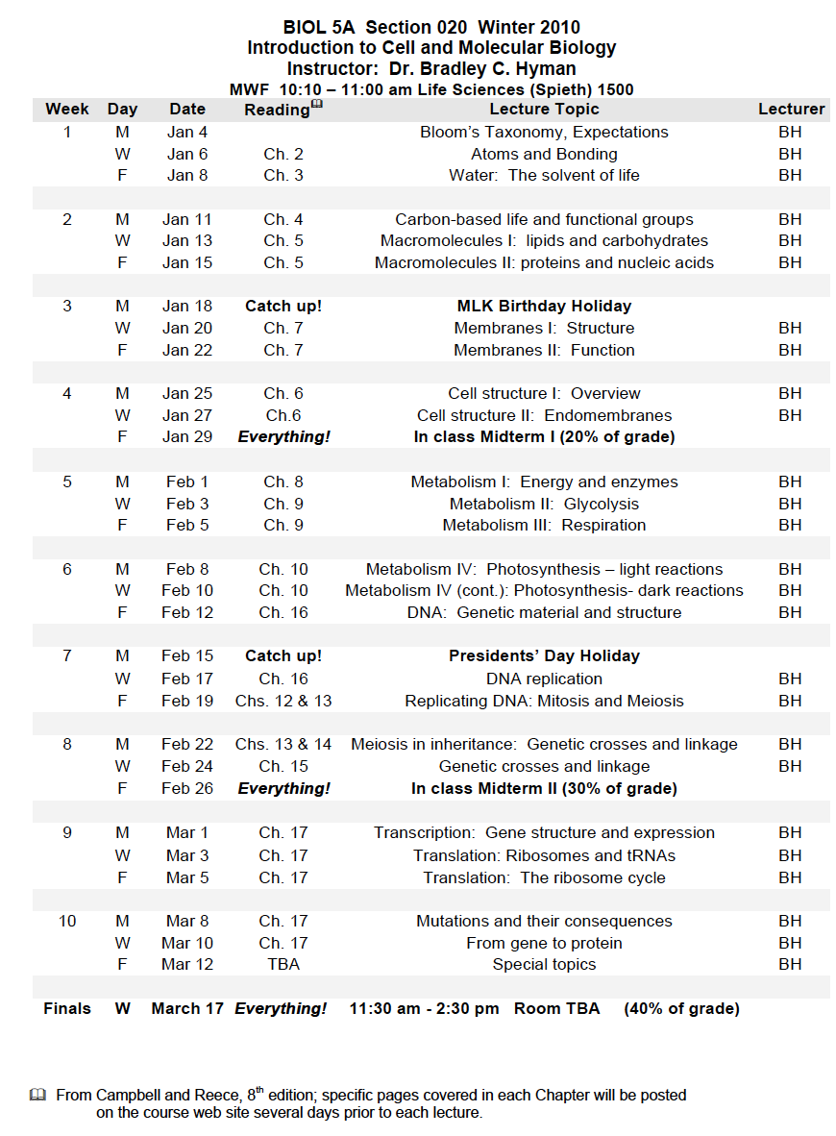
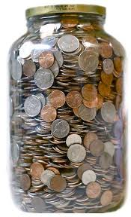
A Teachable Unit is composed of Teachable Tidbits

Slide 19
Framework for developing a Teachable Tidbit:
Identify learning goals/topic
Determine learning outcomes that will indicate if the learning goals are being met
Develop classroom activities to engage students
Check that the activities help the students to achieve the learning goals

Slide 20
To: bbutterfinger@candyco.com
From: ppatty@candyco.com
CC: R&D@candyco.com
Subject: New packaging ideas
Hey Bill,
I was talking with the R and D department and they want us to come up with a new design for our candy packaging. We have a 3x5 inch piece of plastic to roll into tubes that our automated machines will fill with candy, but we need to figure out which way to roll it; widthwise or lengthwise. I need you to figure out which way to roll the plastic tube to maximize our company profits. I know you are the best for the job, don’t let me down.
Peppermint Patty
CEO Candy Company Inc.

Slide 21
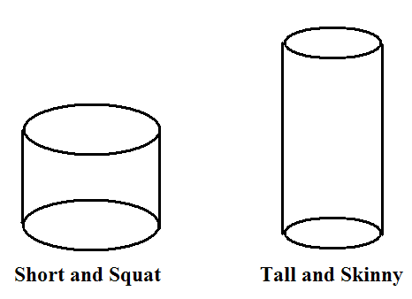
One Minute Writing
Which way is the best way to roll the 3x5 piece of plastic to maximize the company profits?

Slide 22
Think Pair Share
Turn to a neighbor and discuss your thoughts on your writing.
Clicker Question:
1 = Short and squat
2 = Tall and skinny
3 = They are the same

Slide 23
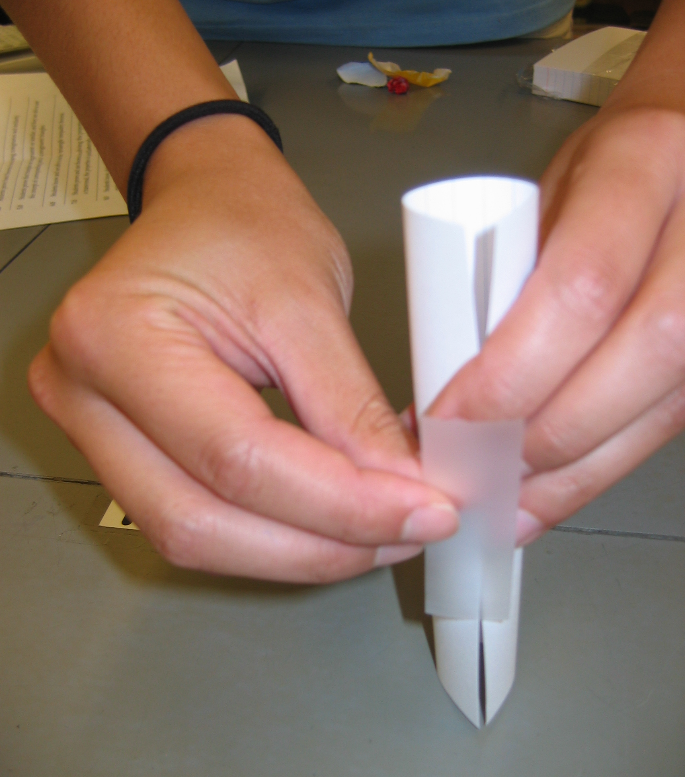
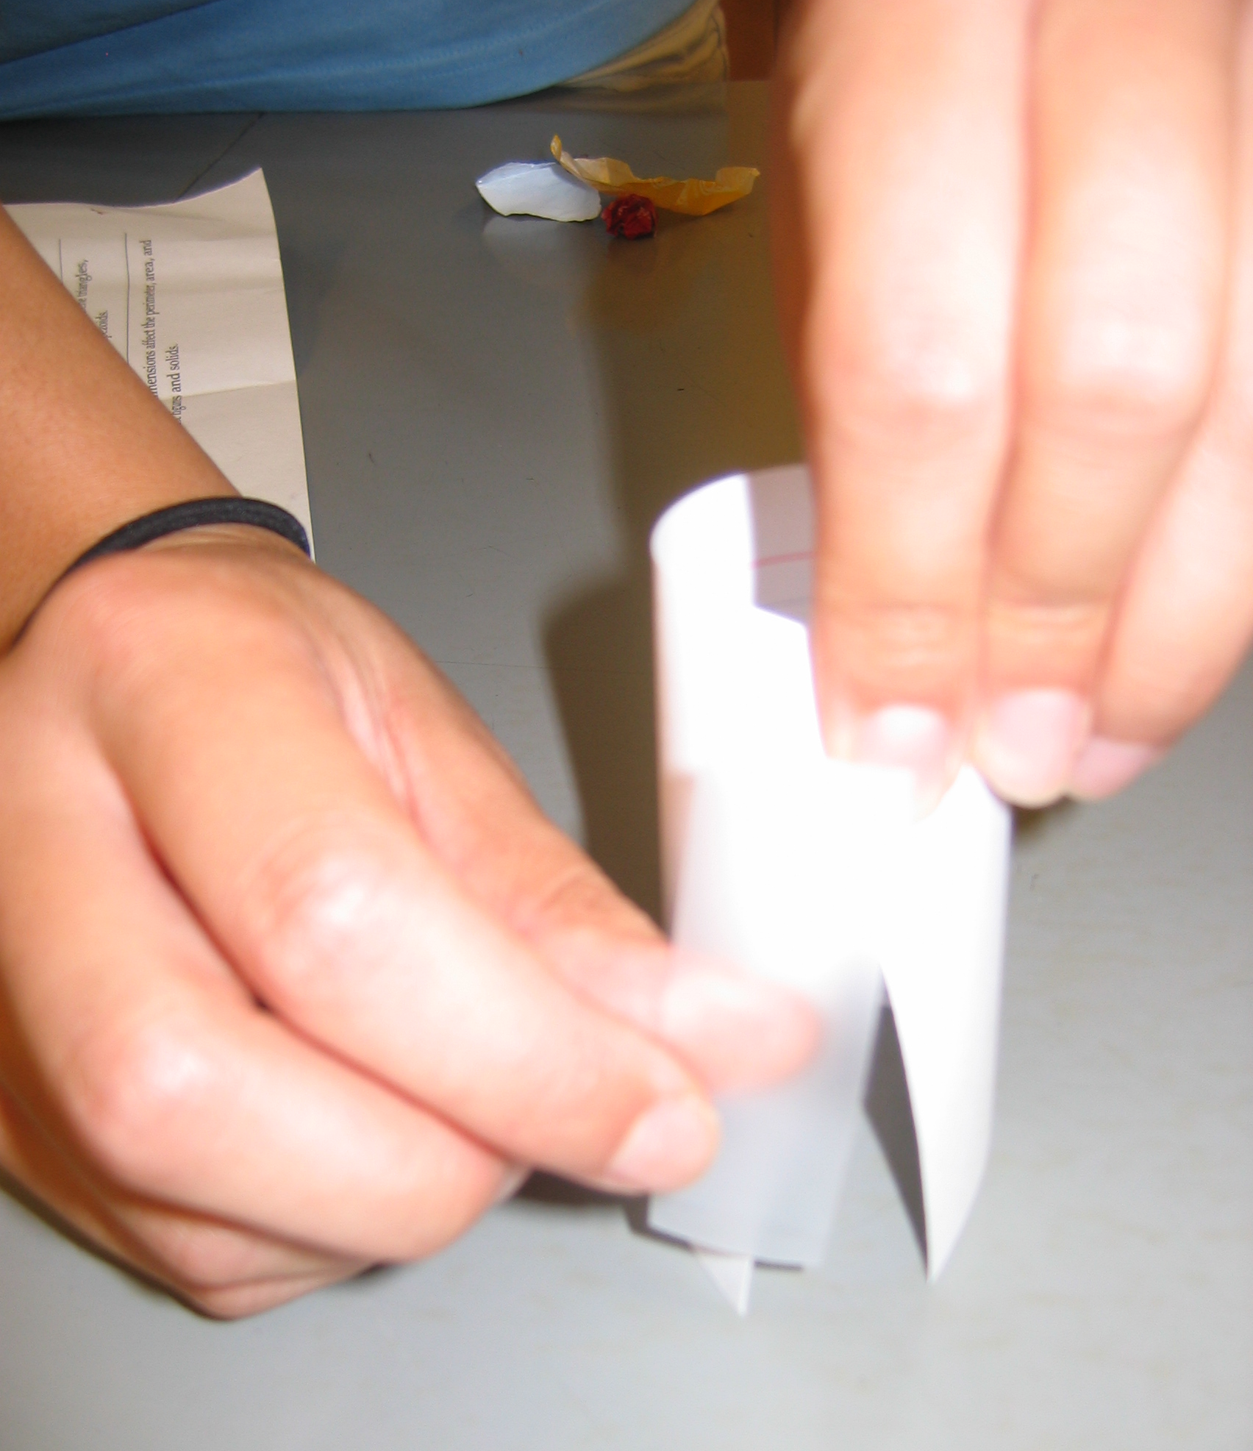
Folding Directions
Tall and Skinny: fold 3 x 5 card widthwise and tape the edges together
Short and Squat: fold 3 x 5 card lengthwise and tape the edges together
Then fill each shape with candy and see which one holds less product.

Slide 24
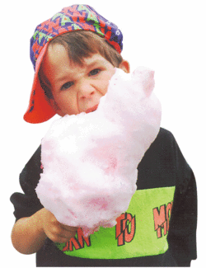
One Minute Writing
From the perspective of the consumer, which shape would be in your best interest to buy and why?

Slide 25
Geometry State Content Standards
8.0 Students know, derive, solve problems involving … volume … of common geometric figures.
9.0 Students compute the volumes … and commit to memory the formulas for … cylinders.

Slide 26
Prior Knowledge
What students should know:
  How to find circumferences, perimeters, and areas of geometric shape
  How to solve equations with multiple variables using substitution

Slide 27
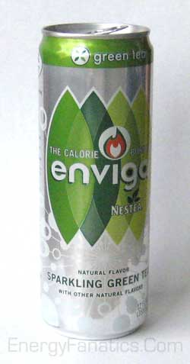
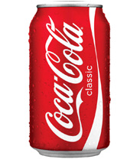
Closing Activity
Enviga is a tall and skinny 12 ounce can
Coca-Cola is a shorter 12 ounce can
Clicker Question
Which can would be better for a company to make?
1 = Enviga can
2 = Coca-Cola can

Slide 28


6 pack of 8 ounce Coca-Cola: $2.69
12 pack of 12 ounce Coca-Cola: $5.99
Knowing which one is ripping you off at the supermarket: Priceless
Something to think about: Why do you think the Coca-Cola® company doesn’t make 6 packs of the normal size coke anymore?

Slide 29
Diversity and Learning Outcomes
Learning styles:
  Kinesthetic, visual, auditory learning during opening activity and presentation
Incorporated into presentation:
  Female CEO in email letter, male packaging department
Learning Outcome (“Teachable tidbit”):
  How to determine the volume of a cylinder
Teachable unit:
  Computing volumes and surface areas of various geometric shapes

Slide 30
Create a Concept Map using the following terms:
Backward Design, Active Learning, Assessment, Diversity, Teachable Unit, Teachable Tidbit, Alignment
Feel free to use any additional terms from the Scientific Teaching book

Slide 31

