Slide 1
FBI Challenge: Exponential Growth of Product Using Polymerase Chain Reaction (PCR)

Slide 2
Intro
Using math to solve a biological science problem
Students will use their knowledge of:
Exponential equations
Molecular biology

Slide 3
HS Biology Standards
5c.Students know how genetic engineering(biotechnology) is used to produce novel biomedical and agricultural products.
5d.* Students know how basic DNA technology (restriction digestion by endonu­cleases, gel electrophoresis, ligation, and transformation) is used to construct recombinant DNA molecules.

Slide 4
Algebra II Standard
Construct and compare linear, quadratic, and exponential models and solve problems
Linear, Quadratic, and Exponential Models F-LE
Distinguish between situations that can be modeled with linear functions and with exponential functions
a. Prove that linear functions grow by equal differences over equal intervals, and that exponential functions grow by equal factors over equal intervals

Slide 5
Learning Goals
Apply the steps of PCR to predict how modifications will affect the production of novel products
Know how to predict the amount of product given a number of cycles by looking at a graph of a PCR reaction

Slide 6
Your Offer
Dear biology student at Dynamic High School,
You have been selected to be a consultant for my FBI crime lab. I’ve heard of your molecular biology skills and would prefer asking your help instead of my colleagues. I was given an offer from DNA-Mart for a PCR using a supply of a single primer. Is this a valid option?
Sincerely,
Prudence B. Thrifty

Slide 7
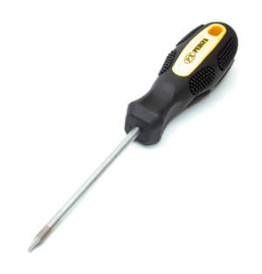
PCR: Exponential Growth
y=2^{x}
y → number of copies of DNA
X → number of cycles

Slide 8
VIDEO
www.dnalc.org
Click on “3-D Animation Library”
Under “Experiments & Techniques”, click “Polymerase Chain Reaction”
(Third one on the top row)

Slide 9
Strip Sequence Answers
The first process in Polymerase Chain Reaction is to raise the temperature to near boiling
After this step the DNA denatures into single strands
The temperature is decreased.
Then the short DNA sequences known as primers bind, or anneal, to complementary matches on the target DNA sequences
As the temperature is slightly raised, Taq polymerase, an enzyme, binds to primed sequences and adds nucleotides
For additional cycles the process of denaturing, annealing and extending are repeated to make additional DNA copies

Slide 10
Your Materials
Colored Strips (DNA Strands)
Paperclips (Primers)
Calculator
Graph Paper
Ruler

Slide 11
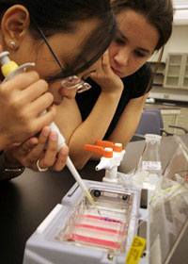
Prudence B. Thrifty wants to know…
If PCR using a single type of primer can yield the same amount of product as a normal PCR with two primers.

Slide 12
Your Offer
Dear biology student at Dynamic High School,
You have been selected to be a consultant for my FBI crime lab. I’ve heard of your molecular biology skills and would prefer asking your help instead of my colleagues. I was given an offer from DNA-Mart for a PCR using a supply of a single primer. Is this a valid option?
Sincerely,
Prudence B. Thrifty

Slide 13
Your Reward
Would you rather be paid
A lump sum of $10,000
$2 today to be doubled everyday for fifteen (15) days

