Slide 1
Dilutions and Concentrations
A true story

Slide 2
Standards
Science: Chemistry
6.d. Students know how to calculate the concentration of a solution.
Investigation and Experimentation
1a. Select and use appropriate tools and technology to perform tests, collect data, analyze relationships, and display data.
Math: Algebra I
15.0 Students apply algebraic techniques to solve rate problems, work problems and percent mixture problems.

Slide 3
Prior Knowledge
The students are expected to already know the following:
1. How to use a micropipette.
2. Units of measurement.
3. Manipulating Algebraic Equations

Slide 4
Learning Goal
Understand how to dilute different given concentrations (in %) to achieve a desired working concentration.

Slide 5
Learning Objective
Students will be able to calculate and prepare a dilution using the concentration equation.

Slide 6
Think-Pair-Share
Compare and Contrast the 2 samples.

Slide 7
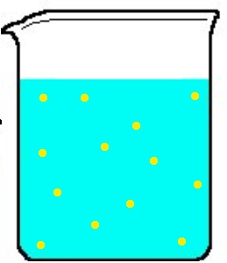
Needed Definitions
Concentration: The amount of a substance in a given volume.

Slide 8
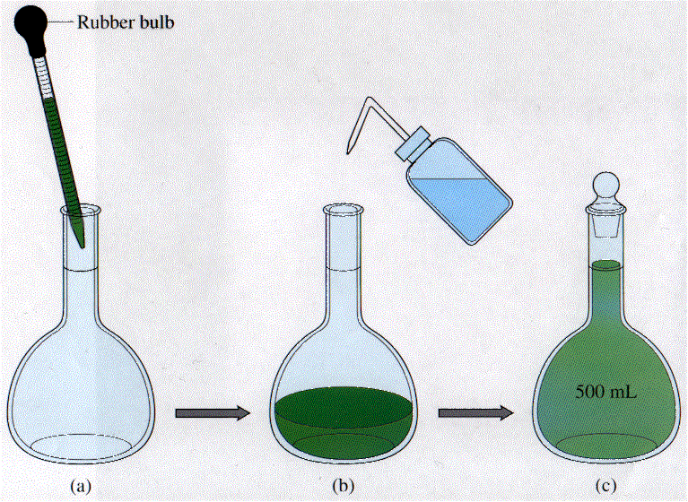
Needed Definitions
Dilution: The process of reducing the concentration.

Slide 9
Needed Definitions
Stock Solution: A higher concentration solution that will be changed to a lower concentration by dilution.
Stock
(initial concentration)
Dilution
(final concentration)

Slide 10
Concentration Equation
Initial Concentration (C_{i}) x Initial Volume (V_{i})
equals
Final Concentration (C_{f})x Final Volume (V_{f})
C_{i} x V_{i} = C_{f} x V_{f}
_{(Initial) (Final)}

Slide 11
EXAMPLE: 6% Loading Dye is a stock solution. If the final volume of a solution is 12 μl calculate the amount of 6% Loading Dye and water you would use to dilute the Loading Dye to 1%.
6% Loading Dye is a stock solution. If the final volume of a solution is 12 μl calculate the amount of 6% Loading Dye and water you would use to dilute the Loading Dye to 1%.
C_{i} = 6%
V_{f} = 12 μl
V_{i} = X
C_{f} = 1%
C_{i} x V_{i} = C_{f} x V_{f}
V_{i} = 2 μl dye
6% Dye
1% Dye
6% x V_{i} = 1% x 12 μl

Slide 12
V_{f} -V_{i} = amount of water to add
V_{f} = 12 μl
V_{i} = 2 μl dye
12 μl – 2 μl dye = 10 μl water

Slide 13
Clicker Question
A stock solution of 50% TAE buffer has to be diluted. You need 100 ml of 1% TAE. Calculate how much 50% TAE has to be used.
1) 100 ml 2) 10 ml
3) 20 ml 4) 2 ml

Slide 14
Activity
As a pair…
Tube1: Make 1,000 μl of a 1.3% solution from your 100% stock “A”.
Tube 2: Make 1,000 μl of a 42% solution from your 100% stock “A”.
Show your work on the back of the card
Raise your hand when you have finished your 2 “A” samples so the instructor can check your work.

Slide 15
Assessment. Work on your own.
Tube 3: Make 1000 μl of a 1% solution from your 40% Stock “B”.
Raise your hand when you have finished your “B” sample so the instructor can check your work.

Slide 16
Did you meet the learning objectives?
Were you able to calculate dilutions using the concentration equation?
C_{i} x V_{i} = C_{f} x V_{f}
Were you able to prepare dilutions using your calculations?

